Slide 1
Convolutional Networks, Part II
Gary Cottrell
with many slides from Rob Fergus

Slide 2
This lecture
Investigating invariance abilities
The structure of very deep models
How to visualize the features
Adversarial examples
Some training tips

Slide 3
Translation (Vertical)
Output
Layer 1
Layer 7

Slide 4
Scale Invariance
Output
Layer 1
Layer 7

Slide 5
Rotation Invariance
Output
Layer 1
Layer 7

Slide 6
Clicker Question
Invariance to rotation is
Built into the architecture
A result of training
Not actually a feature of what I just showed
Only for entertainment centers
A or D, I’m not sure which

Slide 7
Clicker Question
Invariance to rotation is
Built into the architecture
A result of training
Not actually a feature of what I just showed
Only for entertainment centers
A or D, I’m not sure which

Slide 8
Clicker Question
Invariance to size is
Built into the architecture
A result of training
Not actually a feature of what I just showed
Only for entertainment centers
A or D, I’m not sure which

Slide 9
Clicker Question
Invariance to size is
Built into the architecture
A result of training
Not actually a feature of what I just showed
Only for entertainment centers
A or D, I’m not sure which

Slide 10
Clicker Question
Invariance to translation is
Built into the architecture
A result of training
Not actually a feature of what I just showed
Only for entertainment centers
A or D, I’m not sure which

Slide 11
Clicker Question
Invariance to translation is
Built into the architecture
A result of training
Not actually a feature of what I just showed
Only for entertainment centers
A or D, I’m not sure which

Slide 12
Very Deep Models (1)
[Very Deep Convolutional Networks for Large-Scale Image Recognition, Karen Simonyan & Andrew Zisserman, arXiv:1409.1556, 2014] (VGG)
Lots of 3x3 conv layers: more non-linearity than single 7x7 layer
Close to SOA results on Imagenet: 6.8% top-5 val
Can be hard to train

Slide 13
Very Deep Models (2)
[Going Deep with Convolutions, Szegedy et al., arXiv:1409.4842, 2014]
GoogLeNet inception module:
Multiple filter scales at each layer
Dimensionality reduction to keep computational requirements down
12 times fewer parameters than Alexnet
number of filters
1x1
3x3
5x5
[From http://image-net.org/challenges/LSVRC/2014/slides/GoogLeNet.pptx]
Notes:
What does this do? It recognizes features at 3 different scales

Slide 14
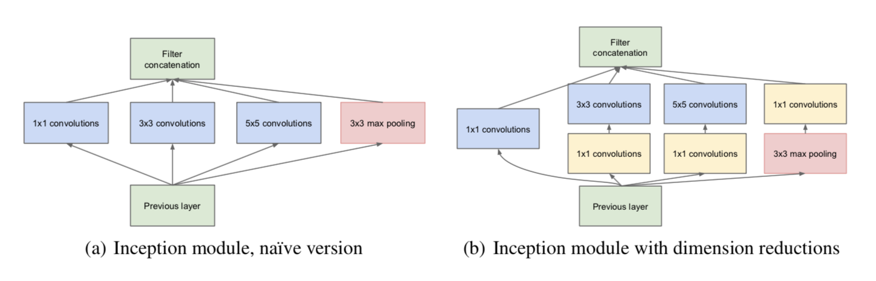
Very Deep Models (2)
[Going Deep with Convolutions, Szegedy et al., arXiv:1409.4842, 2014]
Why 1x1 convolutions?
Reduces dimensionality
Notes:
What does this do? It recognizes features at 3 different scales

Slide 15
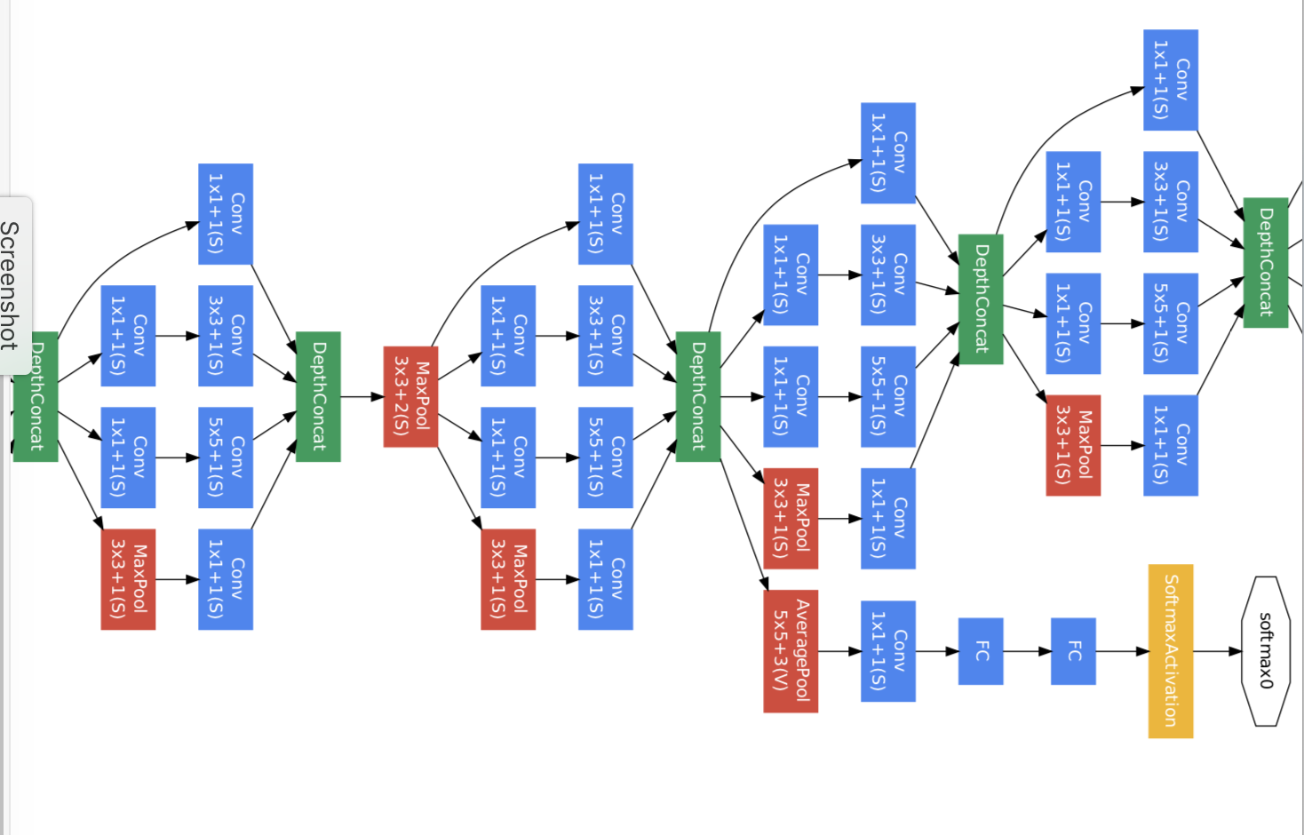
Very Deep Models (2)
Here, “depth concatenation” means taking all of the filters of the same shape and concatenating them along the channel (feature) dimension
Notes:
What does this do? It recognizes features at 3 different scales

Slide 16
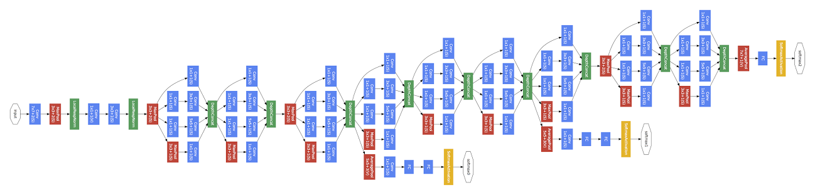
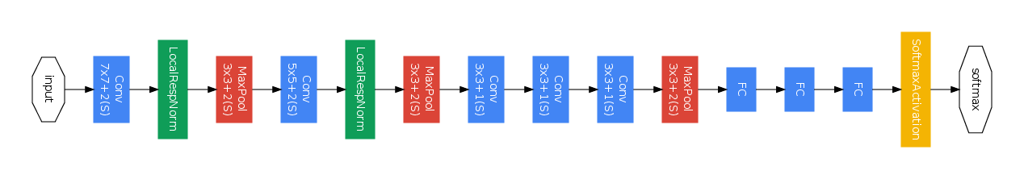
GoogLeNet vs Previous Models
[Going Deep with Convolutions, Szegedy et al., arXiv:1409.4842, 2014]
GoogLeNet
Convolution
Pooling
Softmax
Other
Zeiler-Fergus Architecture (1 tower)
[From http://image-net.org/challenges/LSVRC/2014/slides/GoogLeNet.pptx]

Slide 17
Google Inception model
832
1024
832
512
512
512
256
480
480
Width of inception modules ranges from 256 filters (in early modules) to 1024 in top inception modules.
Can remove fully connected layers on top completely
Number of parameters is reduced to 5 million
6.7% top-5 validation error on Imagnet
Computional cost is increased by less than 2X compared to Krizhevsky’s network. (<1.5Bn operations/evaluation)
[From http://image-net.org/challenges/LSVRC/2014/slides/GoogLeNet.pptx]

Slide 18
Residual Networks
[He, Zhang, Ren, Sun, CVPR 2016]
Really, really deep convnets don’t train well, E.g. CIFAR10:
Key idea: introduce “pass through” into each layer
Thus only residual now needs to be learned
With ensembling, 3.57% top-5 test error on ImageNet

Slide 19
Visualizing Convnets
Want to know what they are learning
Raw coefficients of learned filters in higher layers difficult to interpret
Two classes of method:
Project activations back to pixel space
Optimize input image to maximize a particular feature map or class

Slide 20
Visualizing Convnets
Projection from higher layers back to input
Several similar approaches:
Visualizing and Understanding Convolutional Networks, Matt Zeiler & Rob Fergus, ECCV 2014
Deep Inside Convolutional Networks: Visualising Image Classification Models and Saliency Maps, Karen Simonyan, Andrea Vedaldi, Andrew Zisserman, arXiv 1312.6034, 2013
Object Detectors Emerge in Deep Scene CNNs, Bolei Zhou, Aditya Khosla, Agata Lapedriza, Aude Oliva, Antonio Torralba, ICLR 2015

Slide 21
Projection from Higher Layers
[Zeiler et al. ECCV14]
0
0
Feature Map
....
....
Filters
Filters
Layer 2 Reconstruction
Layer 2: Feature maps
Deconvnet
Convnet
Layer 1 Reconstruction
Layer 1: Feature maps
Visualization
Input Image

Slide 22
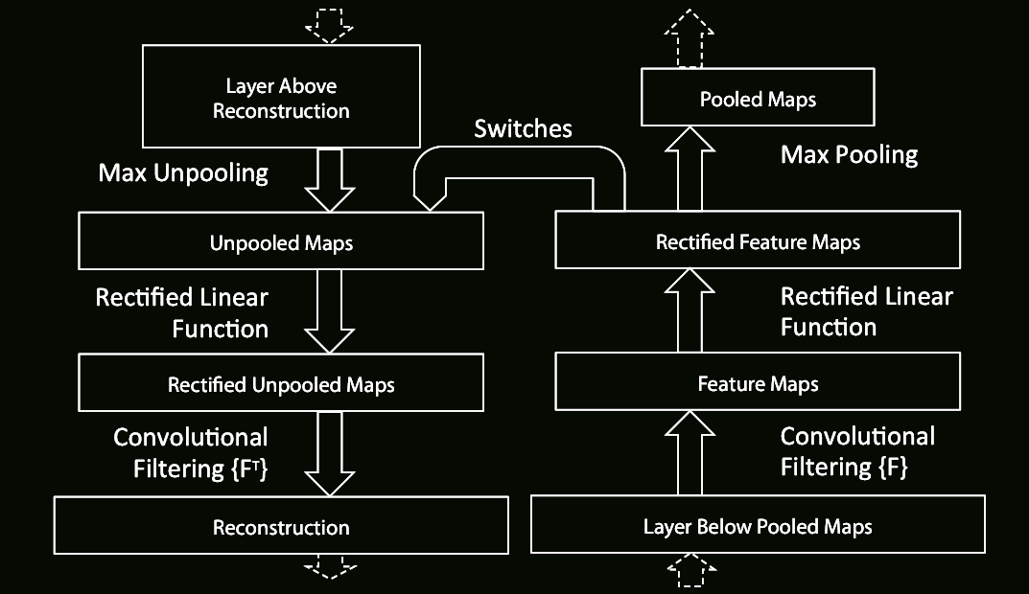
Details of Operation
Deconvnet layer
Convnet layer

Slide 23
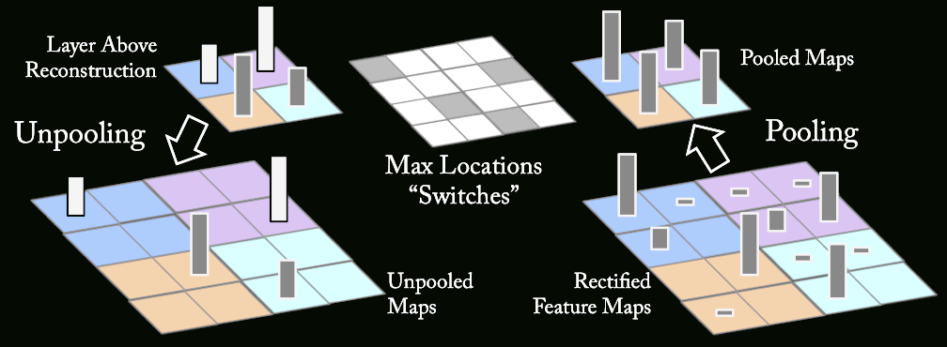
Unpooling Operation

Slide 24
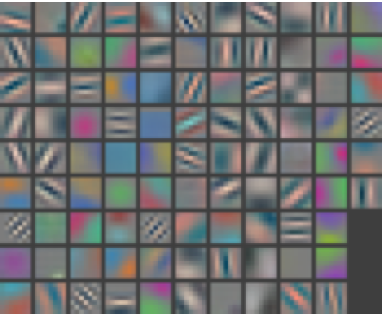
Layer 1 Filters

Slide 25
Visualizations of Higher Layers
Use ImageNet 2012 validation set
Push each image through network
Take max activation from feature map associated with each filter
Use Deconvnet to project back to pixel space
Use pooling “switches” peculiar to that activation
Feature Map
....
Filters
Lower Layers
Input Image
Validation Images

Slide 26
Layer 1: Top-9 Patches
Notes:
receptive field sizes: 7, 27, 75, 107, 139

Slide 27
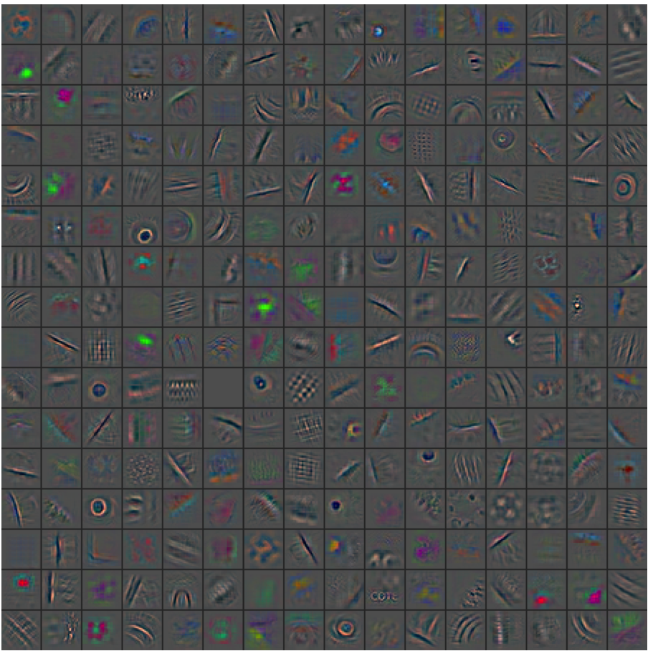
Layer 2: Top-1

Slide 28
Layer 2: Top-9
Computed inverse of maximum activation using deconvnet
A view of invariances

Slide 29
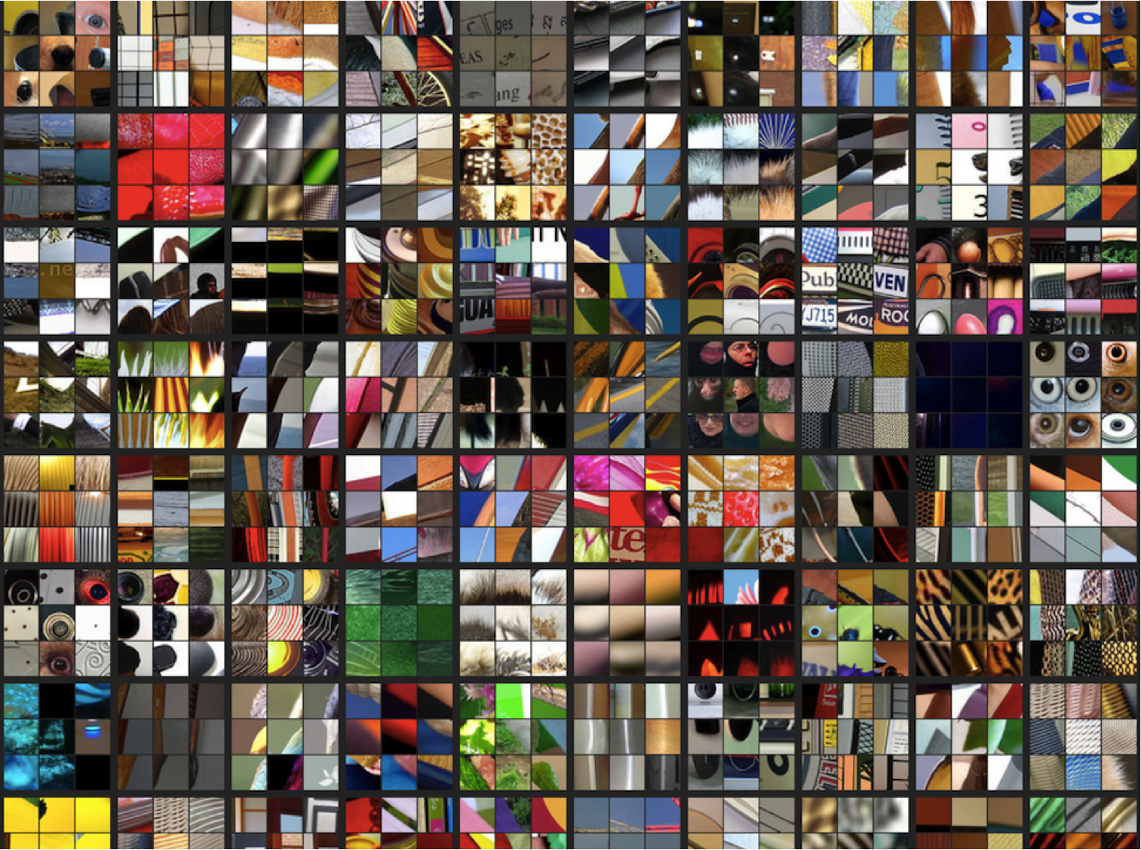
Layer 2: Top-9 Patches
Patches from validation images that give maximal activation of a given feature map

Slide 30
Receptive Fields Get Bigger as you go up...
Receptive field of the first layer is the filter size
Receptive field (w.r.t. input image) of a deeper layer depends on all previous layers’ filter size and strides
Correspondence between a feature map pixel and an image pixel is not unique
Map a feature map pixel to the center of the receptive field on the image in the SPP-net paper
Kaiming He, Xiangyu Zhang, Shaoqing Ren, & Jian Sun. “Spatial Pyramid Pooling in Deep Convolutional Networks for Visual Recognition”. ECCV 2014.

Slide 31
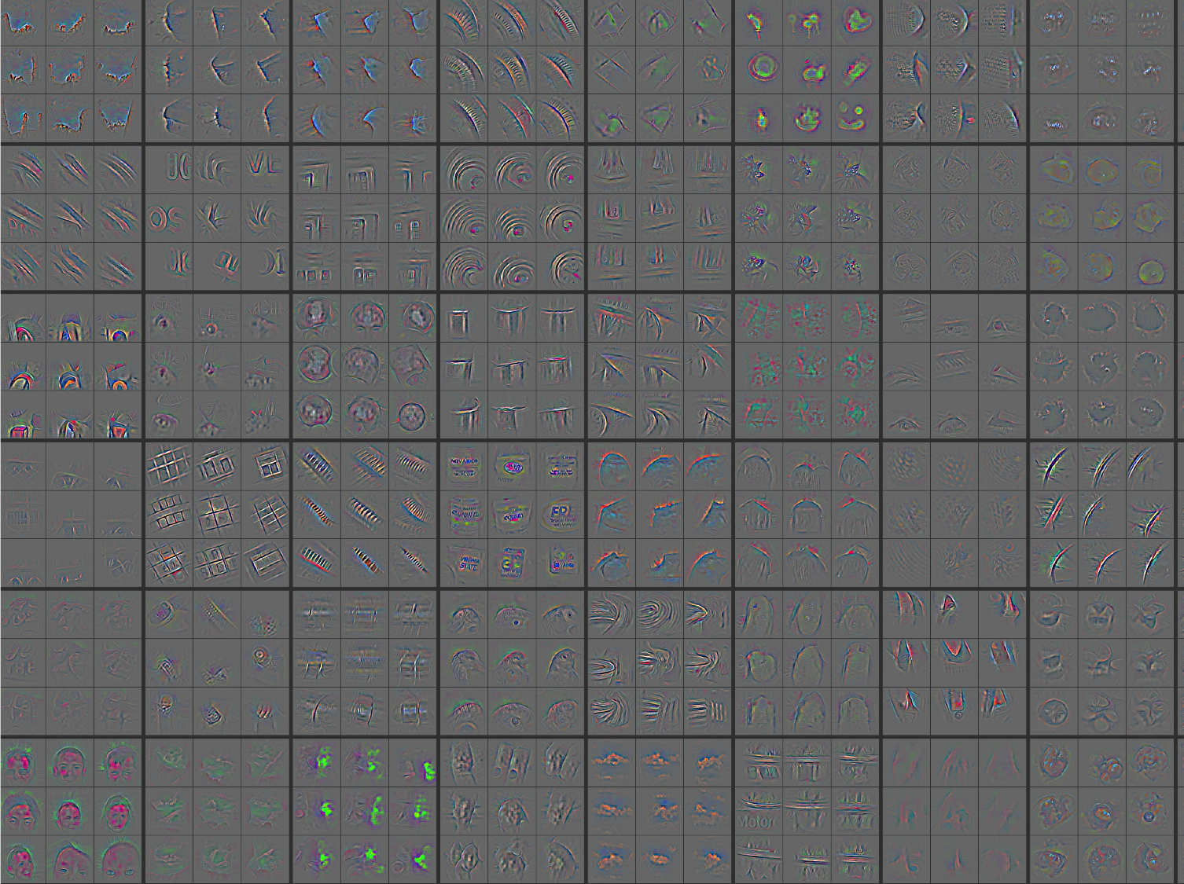
Layer 3: Top-9

Slide 32
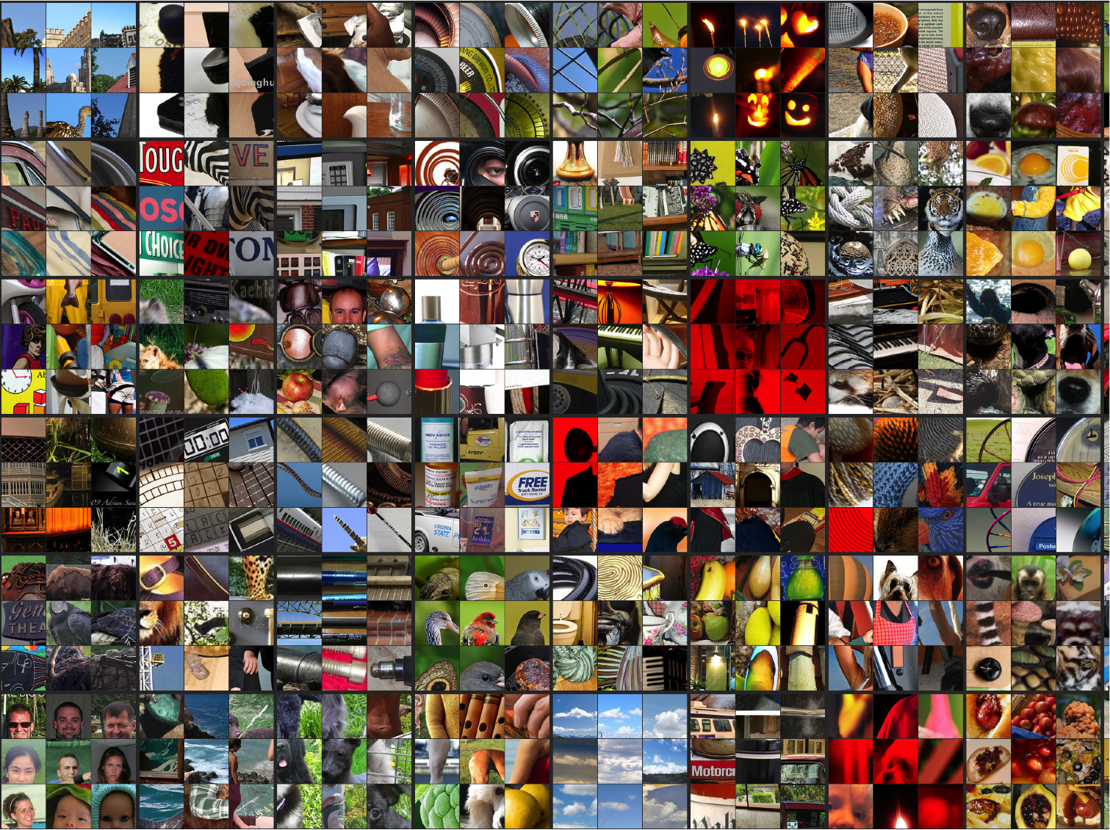
Layer 3: Top-9 Patches

Slide 33
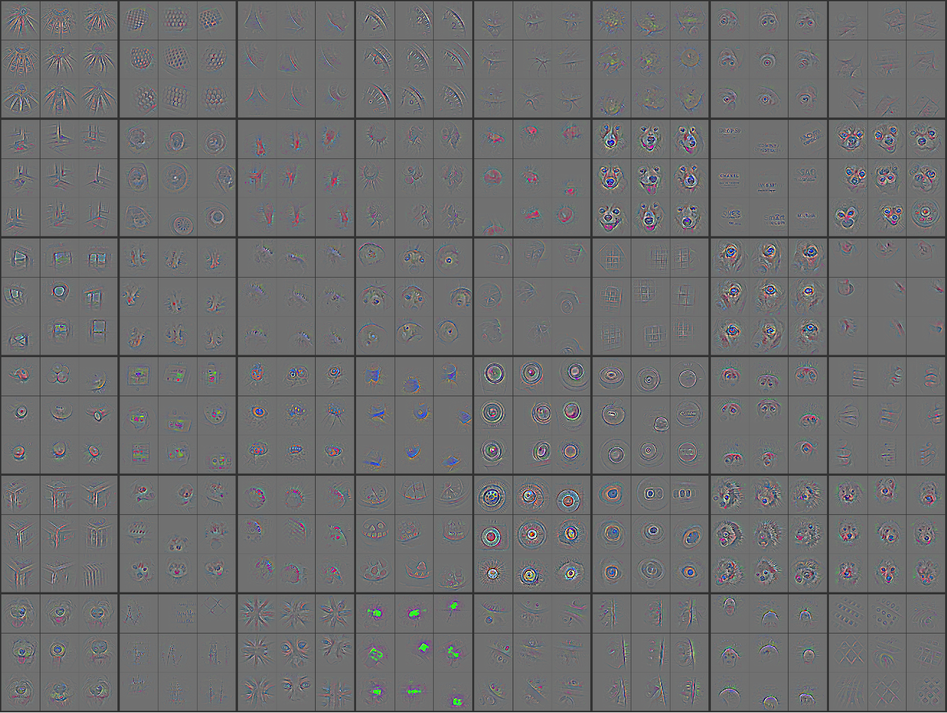
Layer 4: Top-9

Slide 34
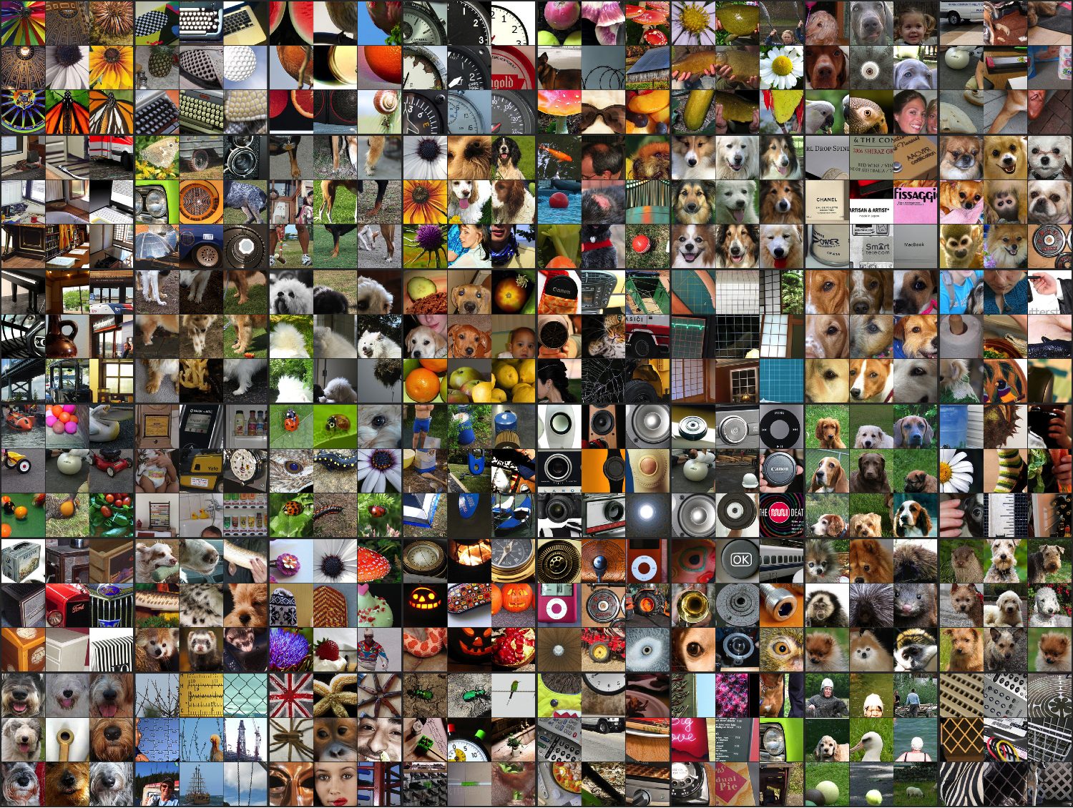
Layer 4: Top-9 Patches

Slide 35
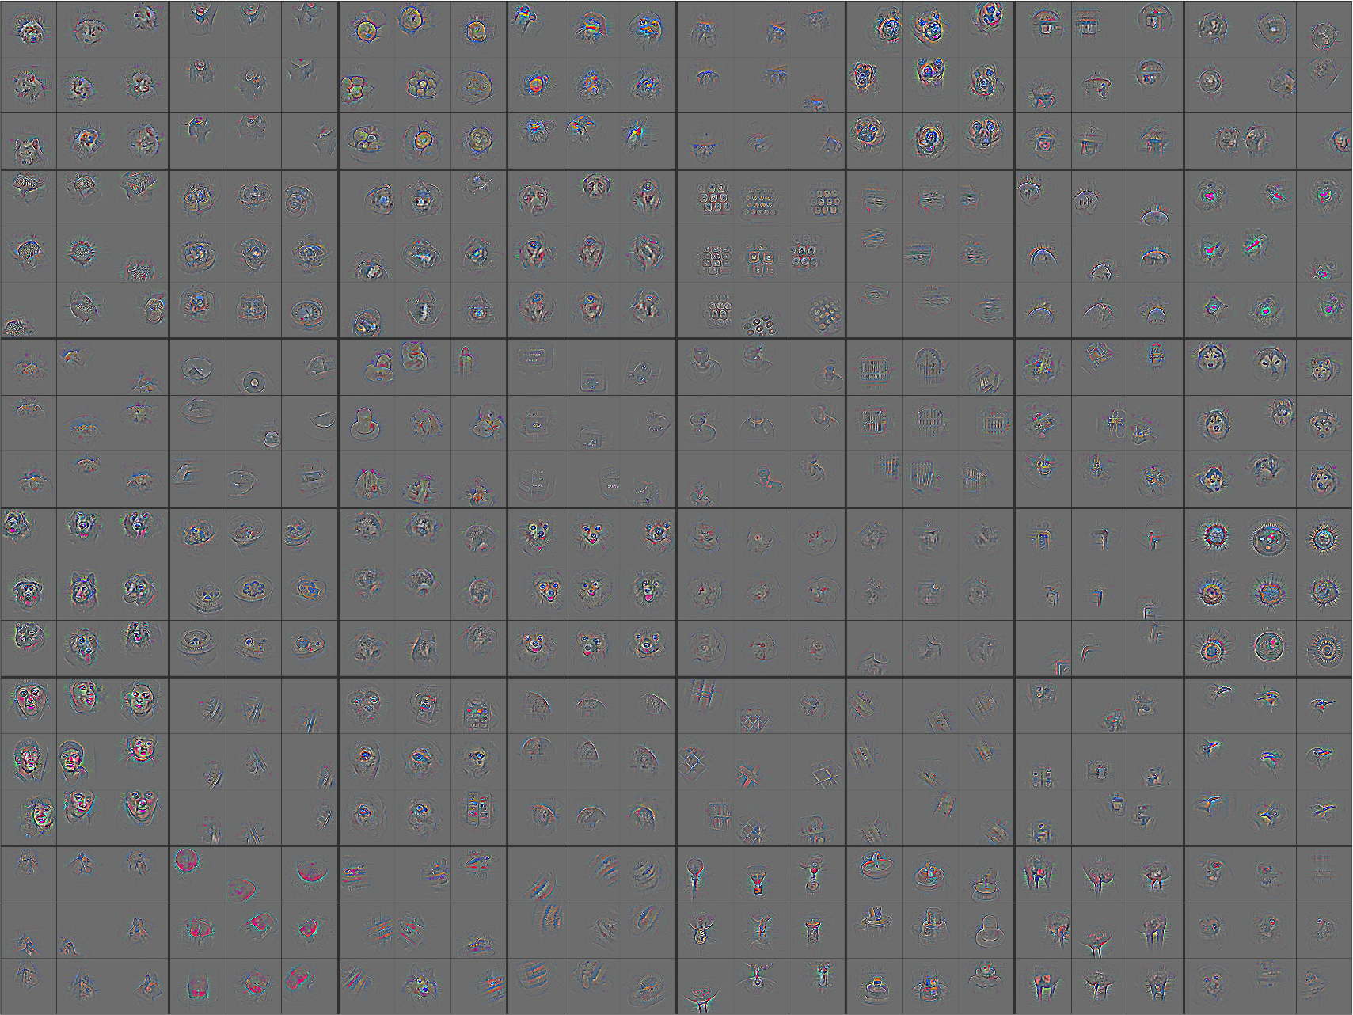
Layer 5: Top-9

Slide 36
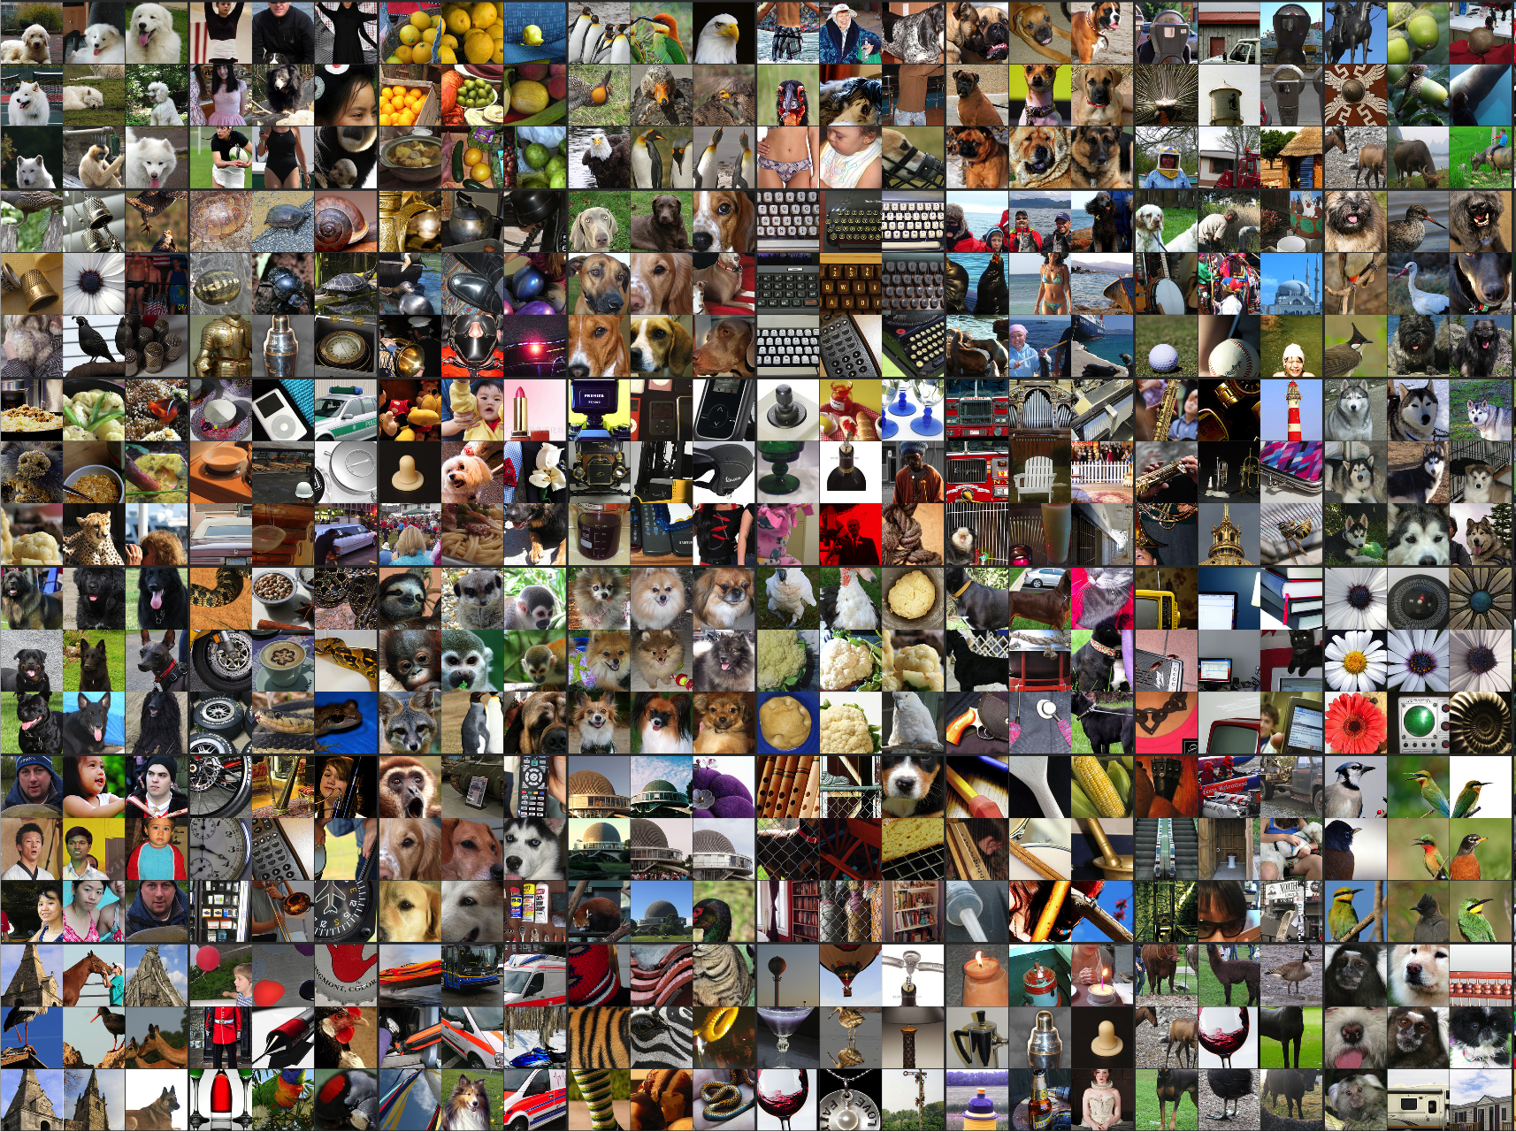
Layer 5: Top-9 Patches

Slide 37
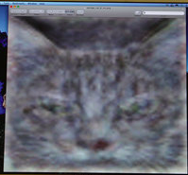
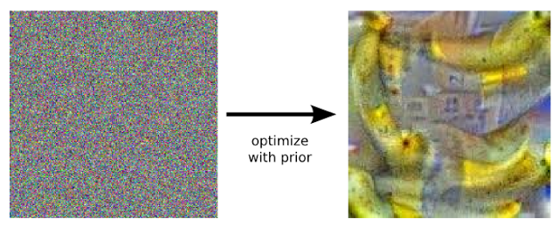
Visualizing Convnets
Optimize input to maximize particular ouput
Lots of approaches, e.g. Erhan et al. [Tech Report 2009], Le et al. [NIPS 2010].
Depend on initialization
Google DeepDream [http://googleresearch.blogspot.ch/2015/06/inceptionism-going-deeper-into-neural.html]
Maximize “banana” output

Slide 38
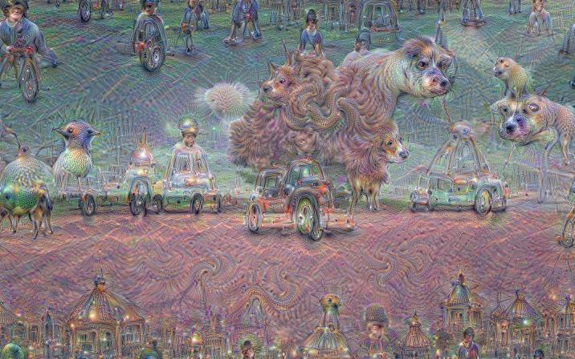
Google DeepDream
https://photos.google.com/share/F1QipPX0SCl7OzWilt9LnuQliattX4OUCj_8EP65_cTVnBmS1jnYgsGQAieQUc1VQWdgQ/photo/AF1QipMYTXpt0TvZ0Q5kubkGw8VAq2isxBuL02wKZafB?key=aVBxWjhwSzg2RjJWLWRuVFBBZEN1d205bUdEMnhB

Slide 39
Adversarial Examples
http://karpathy.github.io/2015/03/30/breaking-convnets/

Slide 40
Adversarial Examples
Szegedy et al. arXiv 1312.6199, 2013

Slide 41
Universal Adversarial Examples
Moosave-Dezfooli et al. arXiv 1610.08401, Oct 2016

Slide 42
Fooling Convnets
Search for images that are misclassified by the network
Intriguing properties of neural networks, Christian Szegedy et al. arXiv 1312.6199, 2013
Deep Neural Networks are Easily Fooled: High Confidence Predictions for Unrecognizable Images, Anh Nguyen, Jason Yosinski, Jeff Clune, arXiv 1412.1897.
This problem is common to any discriminative method

Slide 43
Training Big ConvNets
Stochastic Gradient Descent
Minibatch gradient descent:
Compute (noisy estimate of) gradient on small batch of data & make step
The Adam optimizer is very popular right now
Start with a “big” learning rate and Anneal it
Momentum: Use Nesterov momentum [Sutskever ICML 2012]:

Slide 44
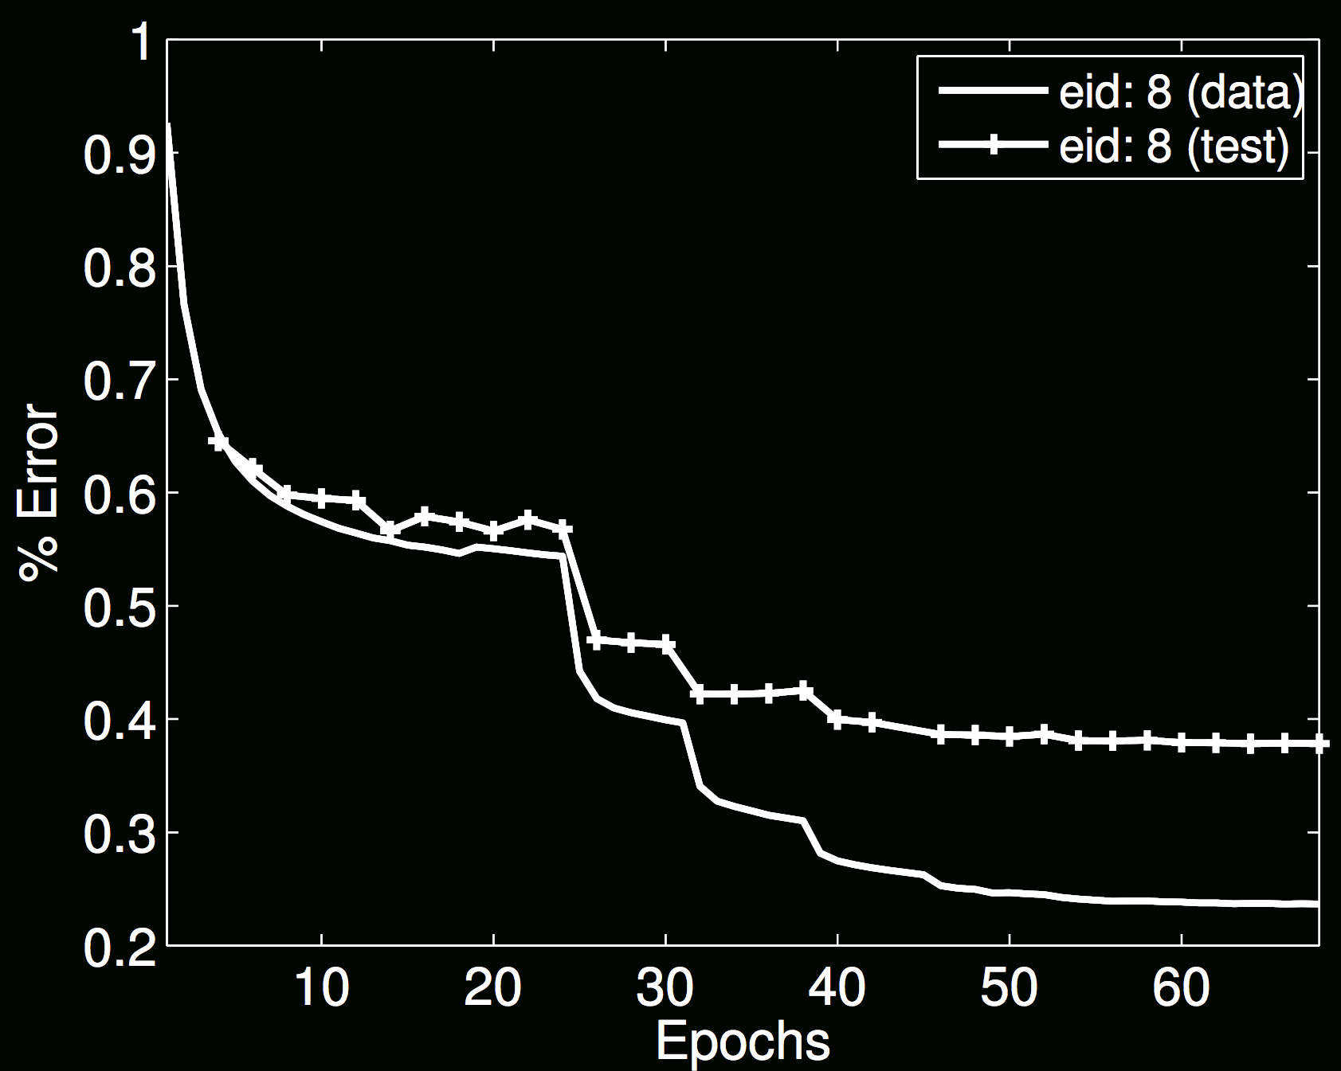
Annealing of Learning Rate
Start large, slowly reduce
Explore different scales of energy surface

Slide 45
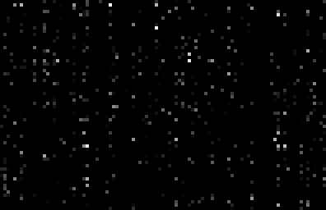

OTHER THINGS GOOD TO KNOW
Check gradients numerically by finite differences
Visualize features (feature maps need to be uncorrelated) and have high variance.
samples
hidden unit
Good training: hidden units are sparse across samples
and across features.
Ranzato

Slide 46
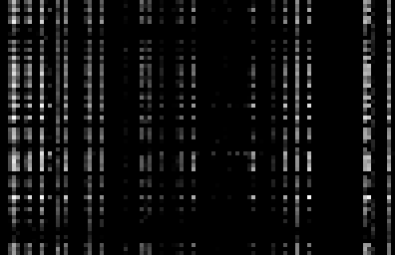
OTHER THINGS GOOD TO KNOW
Check gradients numerically by finite differences
Visualize features (feature maps need to be uncorrelated) and have high variance.
samples
hidden unit
Bad training: many hidden units ignore the input and/or
exhibit strong correlations.
Ranzato

Slide 47
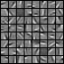
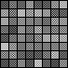
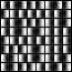
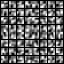
OTHER THINGS GOOD TO KNOW
Check gradients numerically by finite differences
Visualize features (feature maps need to be uncorrelated) and have high variance.
GOOD
BAD
BAD
BAD
too noisy
too correlated
lack structure
Good training: learned filters exhibit structure and are uncorrelated.
Ranzato

Slide 48
OTHER THINGS GOOD TO KNOW
Check gradients numerically by finite differences
Visualize features (feature maps need to be uncorrelated) and have high variance.
Measure error on both training and validation set.
Before wasting a lot of time: Test on a small subset of the data and check the error → 0.
Ranzato

Slide 49
WHAT IF IT DOES NOT WORK?
Training diverges:
Learning rate may be too large → decrease learning rate
BPROP is buggy → numerical gradient checking
Network is underperforming
make net larger
Visualize hidden units/params → fix optmization
Network is too slow
GPU, distrib. framework, make net smaller
Ranzato

Slide 50
Summary
We looked at various invariances:
Translation (pretty good)
Scale (pretty good)
Rotation (not so good)
The structure of very deep models:
GoogleNet, ResNet
How to visualize the features:
Deconvolution
Gradient descent back to the pixels
Adversarial examples
Using the network (gradients)
Universal adversarial examples: Keep moving in directions away from gradient for each image
Some training tips

Slide 51
Some References (mostly historical) (which may or may not be related to the slides!)
K. Fukushima: "Neocognitron: A self-organizing neural network model for a mechanism of pattern recognition unaffected by shift in position", Biological Cybernetics, 36[4], pp. 193-202 (April 1980). http://www.scholarpedia.org/article/Neocognitron
Y. LeCun, L. Bottou, Y. Bengio and P. Haffner: Gradient-Based Learning Applied to Document Recognition, Proceedings of the IEEE, 86(11):2278-2324, November 1998
Hinton, G. E. and Salakhutdinov, R. R., Reducing the dimensionality of data with neural networks. Science, Vol. 313. no. 5786, pp. 504 - 507, 28 July 2006.
Y-Lan Boureau, Jean Ponce, and Yann LeCun, A theoretical analysis of feature pooling in vision algorithms, Proc. International Conference on Machine learning (ICML'10), 2010
Q.V. Le, J. Ngiam, Z. Chen, D. Chia, P. Koh, A.Y. Ng , Tiled Convolutional Neural Networks. NIPS, 2010
http://ai.stanford.edu/~quocle/TCNNweb
Matthew D. Zeiler, Graham W. Taylor, and Rob Fergus, Adaptive Deconvolutional Networks for Mid and High Level Feature Learning, International Conference on Computer Vision(November 6-13, 2011)
Ruslan Salakhutdinov and Geoffrey Hinton, Deep Boltzmann Machines, 12th International Conference on Artificial Intelligence and Statistics (2009).
Hinton, G. E., Krizhevsky, A. and Wang, S, Transforming Auto-encoders. ICANN-11: International Conference on Artificial Neural Networks, 2011
Q.V. Le, M.A. Ranzato, R. Monga, M. Devin, K. Chen, G.S. Corrado, J. Dean, A.Y. Ng., Building high-level features using large scale unsupervised learning. ICML, 2012.
Christian Szegedy, Wojciech Zaremba, Ilya Sutskever, Joan Bruna, Dumitru Erhan, Ian Goodfellow, Rob Fergus (2013) Intriguing properties of neural networks. arXiv:1312.6199v4
Anh Nguyen, Jason Yosinski, Jeff Clune (2014) Deep Neural Networks are Easily Fooled: High Confidence Predictions for Unrecognizable Images. arXiv:1412.1897v4
Seyed-Mohsen Moosavi-Dezfooli, Alhussein Fawzi, Omar Fawzi, Pascal Frossard (2016) Universal adversarial perturbations arXiv:1610.08401v3
(Assume exactly half turn off)

